Slide 1
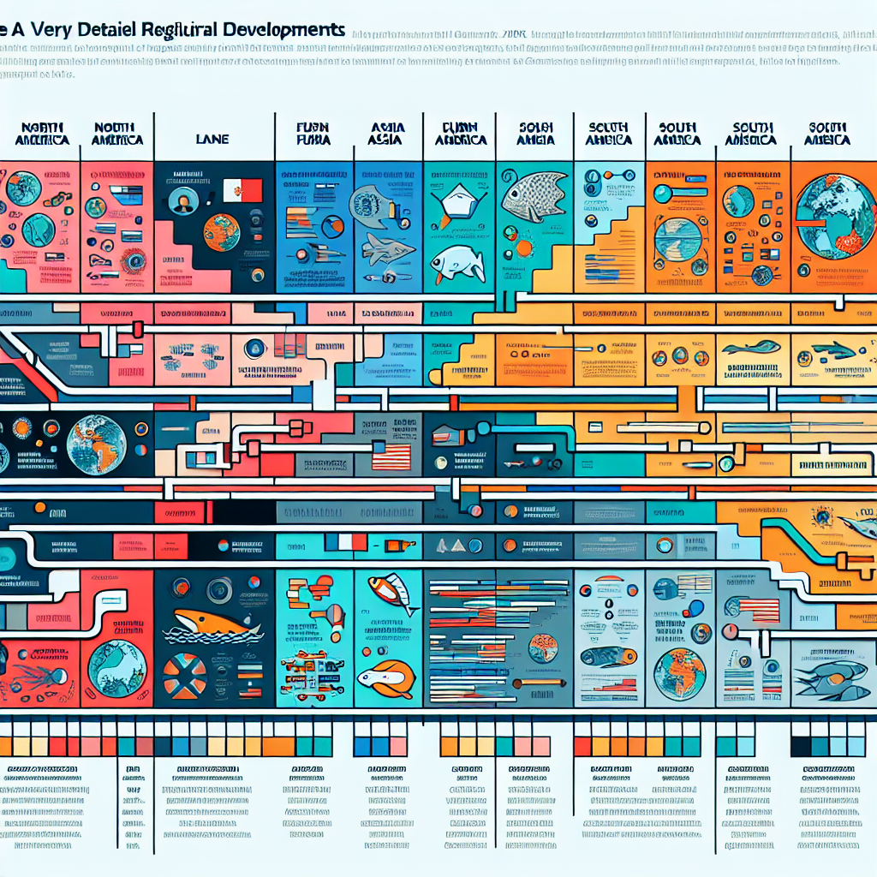
Regulatory Timeline (2016–2025)
2016 | EU | GDPR adopted — Privacy and data governance bedrock for AI training and deployment.
2017 | CN | Cybersecurity Law effective — Security, data localization foundations.
2019 | EU | AI Ethics Guidelines — High-Level Expert Group publishes trustworthy AI principles.
2021 | EU | EU AI Act proposed — Risk-based framework draft unveiled (Apr).
2022 | CN | Algorithm Recommendation Provisions — Filing, transparency, fairness requirements (Mar).
2023 | US | NIST AI RMF 1.0 — Voluntary risk management framework (Jan).
2023 | US | Executive Order 14110 — Safety, testing, reporting for powerful models; agency actions (Oct).
2023 | UK | Pro-Innovation Approach + AI Safety Summit — Principles-led strategy; UK AI Safety Institute launch.
2023 | EU | Political agreement on AI Act — Final trilogue deal (Dec).
2024 | US | OMB M-24-10 — US federal agencies: inventories, impact assessments, governance (Mar).
2024 | EU | AI Act adopted; phased application — Bans and GPAI duties begin first; high-risk obligations phase in through 2025–2026.
2023–2025 | CN | Deep Synthesis/GenAI Measures — Labeling, security review, and filing for generative services.

